Slide 1
Myschedule
Wei Chu Lee
Yifei Huang
Do Hun Ji
Seung Hee Lee

Slide 2
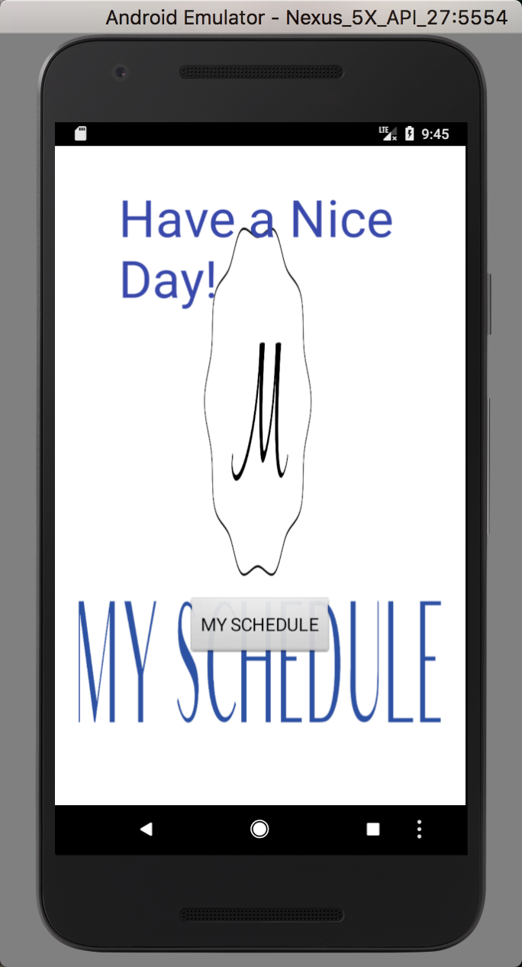
This is the App to let user plans their schedule
This is the startup screen of the Myschedule App.
In this view, user can click the button of “MY SCHEDULE” to either view their schedule or to edit their schedule.
User can also click the button of menu, which shows “...”, in the bottom of page to view the instruction of App.

Slide 3
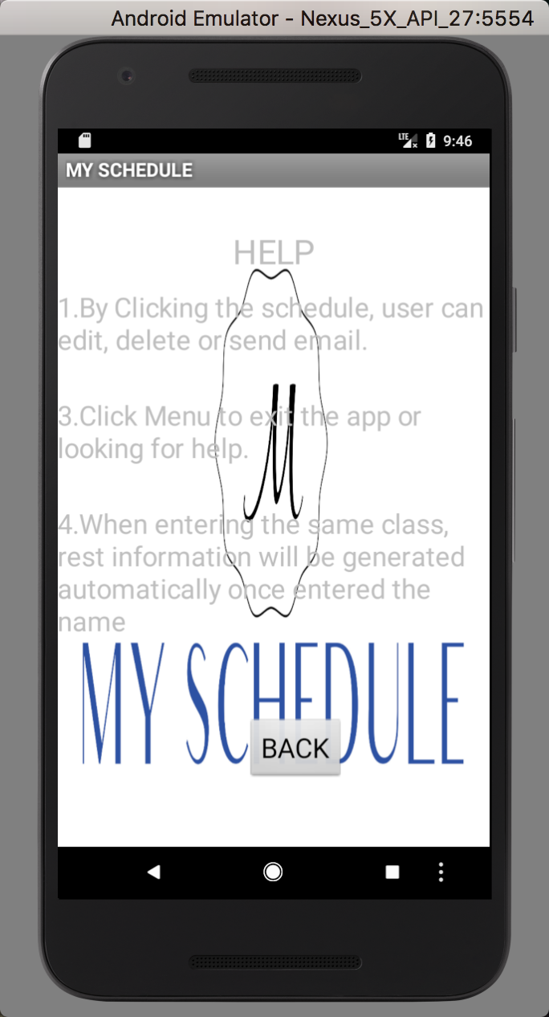
By clicking the button of menu, the view will jump to this page, which describes the instructions of this app.
User can read through the instruction to learn how to edit their schedule
By clicking the “BACK” button, the view will jump back to the startup view.

Slide 4
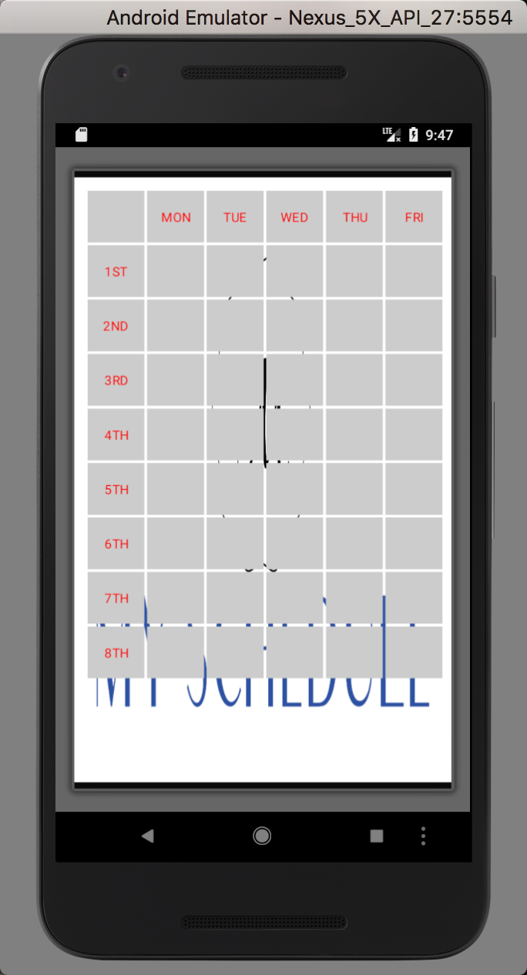
If the user click “MY SCHEDULE”, the view will jump from startup to this view, which clearly shows the whole schedule from Monday to Friday and from 1st class to 8th class.
By clicking the little gray square, the view that is helped for user to edit their schedule will jump out. The users can easily added their schedule in next view. For example, If the users click the green square that had pointed out in the left picture, the user will be able to put their class schedule of Wednesday class for the first class.

Slide 5
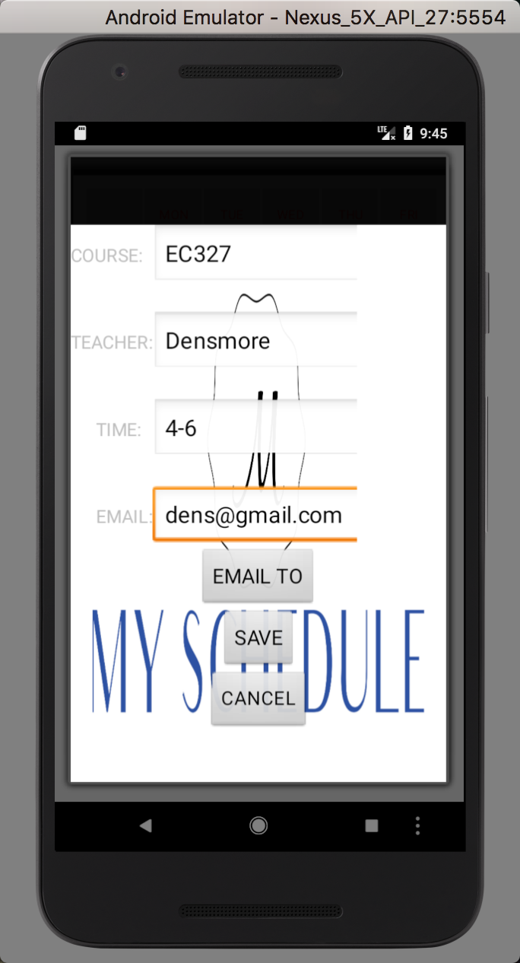
After clicking the grey box in schedule view, the user then can start write the information of their course, teacher, time and email by click the edit box.
Three different buttons are working in this view page. User can click the button of “SAVE” to save the information of their course information into the schedule.
By clicking “CANCEL”, the view will then jump back to the schedule page. The information will then not be save into the schedule.
By clicking “EMAIL TO”, users can write an email to the teacher with the email address that they had saved in schedule.

Slide 6
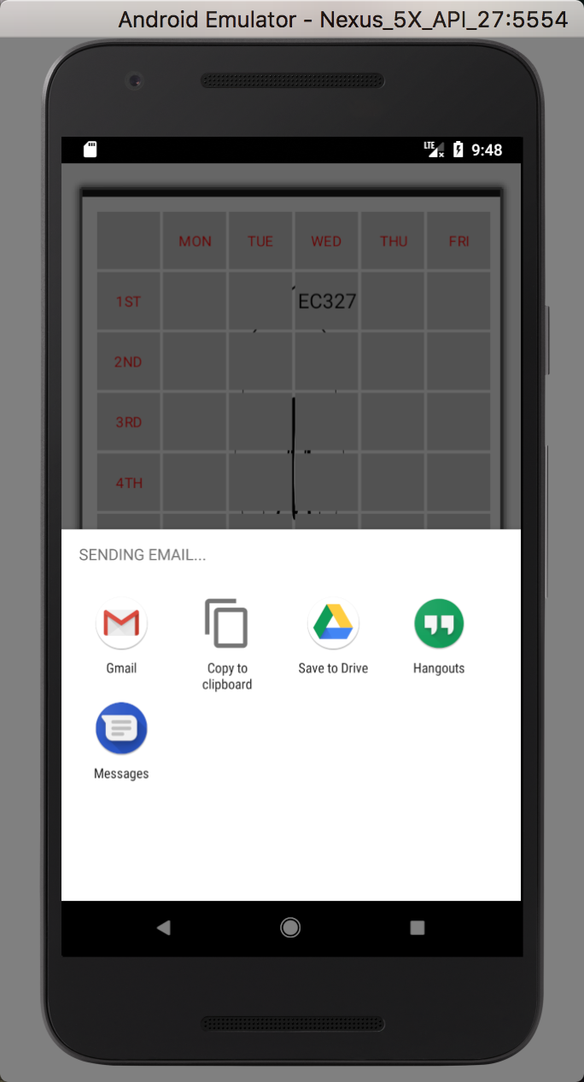
After clicking “EMAIL TO”, user will be able to go to the email intent. By clicking the image of Gmail, users can jump to the App of Gmail to send the email to their teachers.
For example, if user would like to tell their teacher that they will be absent for the class, they can easily email their teacher by using this APP.

Slide 7
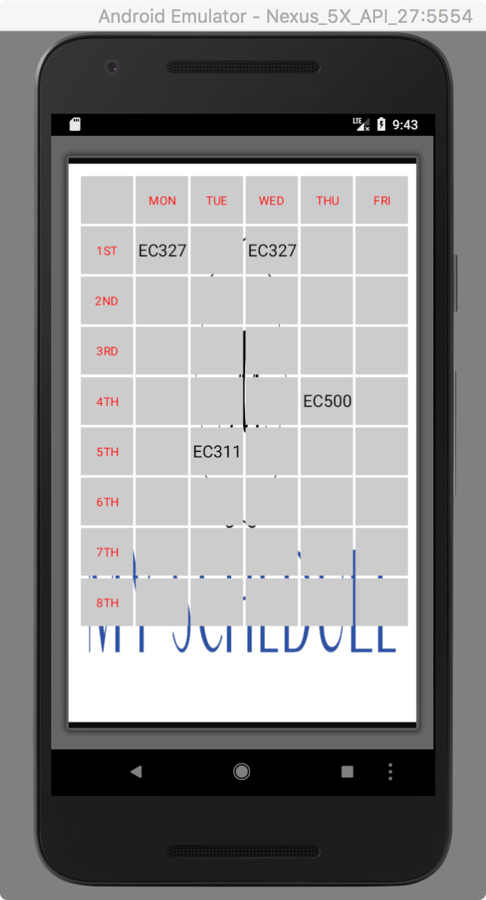
After user click “SAVE” button, the view will then jump back to this schedule page. Then, user can easily see that the schedule they wrote in the previous page has been saved. The little gray square box will now show the name of the course that user have edited.
If the user want to change again their schedule, they are free to click the gray square box again to rewrite all the information.

